Slide 1



Big Data Case Study on Flipkart
Flipkart, India's leading e-commerce platform, has leveraged the power of big data to enhance its user experience, optimize operations, and drive business growth. This case study explores the architecture and processes that enable Flipkart to harness the vast amounts of data it collects to stay ahead of the competition.
JJ

Slide 2
Flipkart Data Platform Architecture
Service-Oriented
Scalable Storage
Diverse Data Management
Flipkart's Data Platform is designed as a service-oriented architecture, allowing for the efficient manipulation of both batch and streaming data. This modular approach enables the company to quickly adapt to changing business needs and user requirements.
The platform has the capacity to store up to 35 Petabytes of data and manage over 800 Hadoop nodes, ensuring Flipkart can handle the exponential growth of its data without compromising performance.
Flipkart's Data Platform utilizes a variety of data storage solutions, including Redis, HBase, and SQL databases, to cater to the diverse data needs of its various microservices and applications.

Slide 3

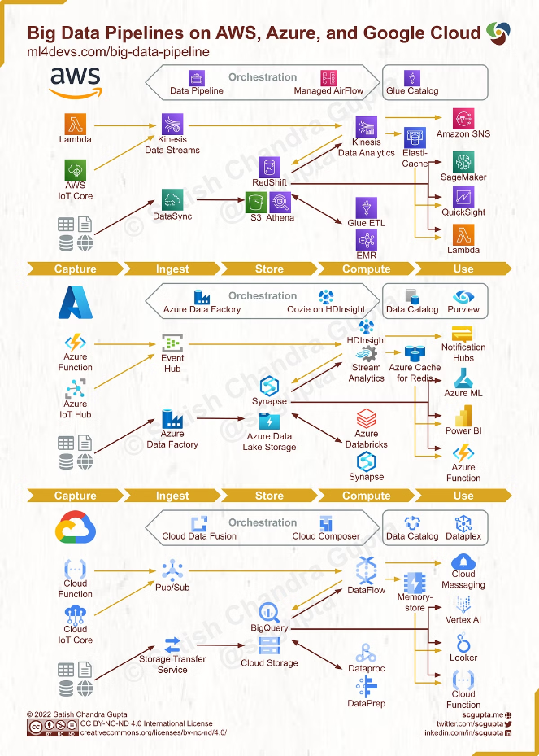
Big Data Ingestion and Processing
1
Ingestion
Flipkart's Big Data Ingestion System serves as the gateway for data to enter the platform, leveraging tools like Specter, Dart Service, and File Ingestor to ingest real-time streams and batch data into the Hadoop Distributed File System (HDFS).
2
Batch Processing
The Batch Compute component of the platform processes large volumes of data collected over time, enabling efficient end-of-day processing and generating comprehensive reports and insights.
3
Streaming
Flipkart's Streaming Platform, powered by Apache Flink, processes data in sub-seconds, allowing the company to make real-time decisions and provide a seamless user experience.

Slide 4

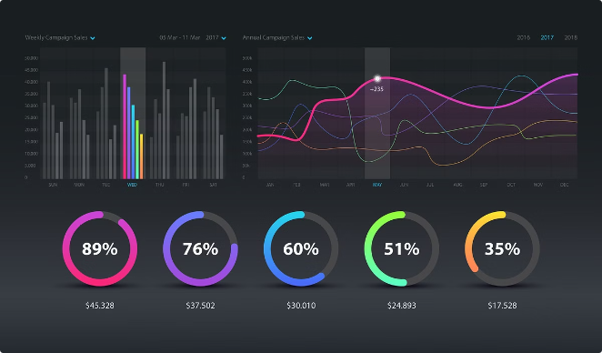
Data Utilization and Insights
Messaging Queue
Flipkart's Messaging Queue system, which includes Producers and Consumers, facilitates the temporary storage and reliable processing of data messages, ensuring efficient communication across the platform.
Real-time Serving
The Real-time Serving system enables Flipkart to gather and access real-time data insights through constantly evolving data pipelines, empowering the company to make informed decisions and enhance the user experience.
Data Lake
Flipkart's Data Lake serves as a centralized repository for the company's vast data, which is then leveraged to generate comprehensive reports, enable ad-hoc queries, and construct knowledge graphs for deeper insights.

Slide 5

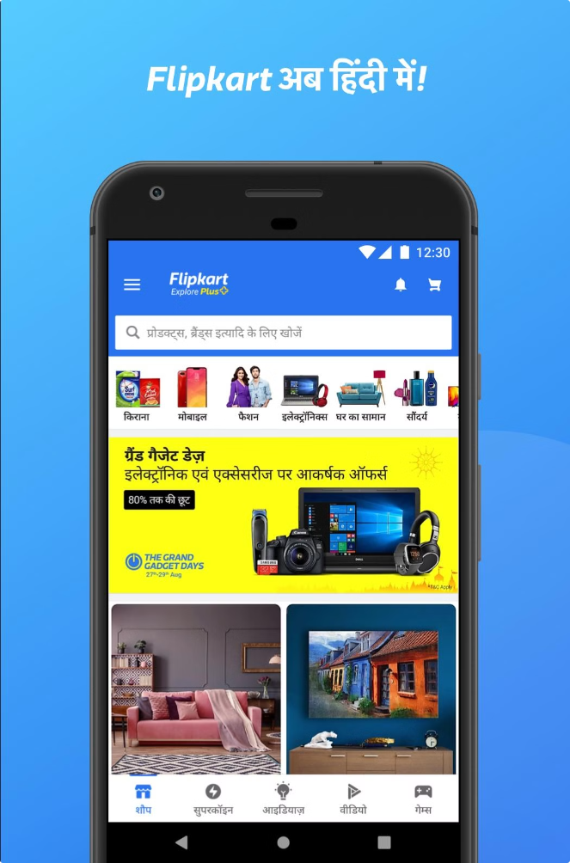
Frontend Technologies
1
React-Native
Flipkart utilizes React-Native to develop mobile apps across Android, iOS, and mWeb platforms, ensuring performance efficiency, native component support, and the ability to deliver over-the-air updates.
2
Proteus
Flipkart's internally developed Proteus framework for Android facilitates over-the-air layout updates and data bindings, accelerating experimentation and bug fixes in mobile app development.
3
Viewport Meta
Flipkart's use of Viewport Meta ensures the responsiveness of its website across diverse screen types and sizes, optimizing the user experience on smartphones, tablets, and desktops.
4
Apple Mobile Web App Capable
Flipkart's implementation of Apple Mobile Web App Capable enhances the iOS user experience by allowing the website to function like a native app from the home screen, improving accessibility and usability.

Slide 6

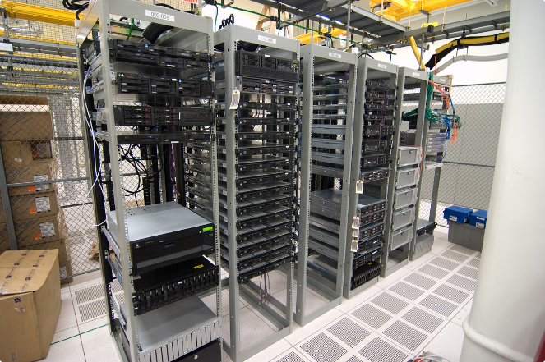
Backend Technologies
Nginx
Flipkart's core web server, optimizing performance under high traffic and handling multiple user connections seamlessly.
Kafka
Apache Kafka, the backbone of Flipkart's messaging queue system, ensuring real-time data feeds and efficient communication across the tech stack.
Dropwizard
A Java-based framework that simplifies the development of scalable RESTful web services for Flipkart's backend.
HDFS
The Hadoop Distributed File System, managing Flipkart's extensive data and enabling robust data analysis for improving user experience.

Slide 7

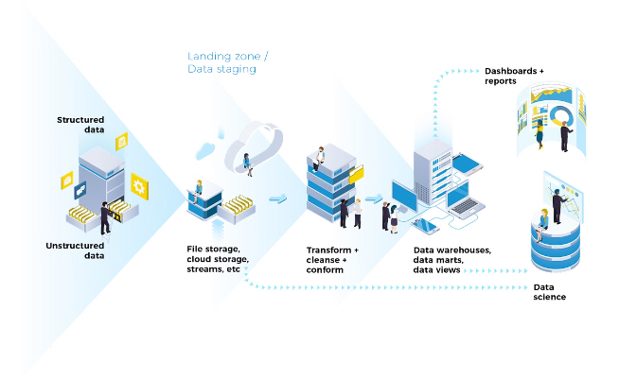
Workflow and Data Management
Batch Processing
Flipkart's Batch Compute component processes large data sets collected over time, generating comprehensive reports and insights.
Stream Processing
The Streaming Platform, powered by Apache Flink, processes data in sub-seconds, enabling real-time decision-making and a seamless user experience.
Data Lake
Flipkart's Data Lake serves as a centralized repository for the company's vast data, which is then leveraged for reports, ad-hoc queries, and knowledge graph construction.

Slide 8

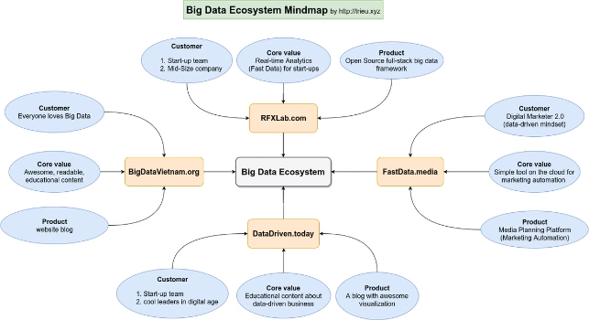
Flipkart's Big Data Ecosystem
Ingestion
Apache Kafka, Specter, Dart Service, File Ingestor
Batch Processing
Hadoop Distributed File System (HDFS), Apache Hive
Stream Processing
Apache Flink
Messaging Queue
Producers, Consumers
Real-time Serving
Everchanging data pipelines
Data Lake
Reports, Ad-hoc Queries, Knowledge Graphs

Slide 9



